Slide 1
Module 2: Central tendency, shape, and difference in means
MSIR 525
Monday, September 23, 2019

Slide 2
Recap of Module 1 (check list from syllabus; see pages 1-2)
We learned about the NHST framework
We developed an understanding of p-values and how they can be used to inform evidence-based management decisions
We compared different types of error that can threaten our inferences and conclusions
We also learned how one can attempt to avoid these errors and disclosures that must be given if a study is underpowered
We contrasted three different research designs (e.g. observational) and two different data collection approaches (e.g., longitudinal)
We learned about different data sources and data types
We summarized several types of validity and phenomena that may threaten them

Slide 3
Agenda for Module 2
9/23/2019
Central tendency and shape; interpretation and communication; issues in datasets
9/25/2019
Assess whether or not two means are *statistically* different from each other (i.e., a t-test)
9/30/2019
Assess whether or not multiple means are *statistically different from each other (i.e., ANOVA test)
10/2/2019
Module 2 recap and software tutorial (R must be installed by this date!!)
10/7/2019
In-class exercise for credit (i.e., a hackathon)
Applying what we learned in M2 to ascertain whether or not a meaningful group difference exists

Slide 4
Agenda for Module 2
9/23/2019
Central tendency and shape; interpretation and communication; issues in datasets
9/25/2019
Assess whether or not two means are *statistically* different from each other (i.e., a t-test)
9/30/2019
Assess whether or not multiple means are *statistically different from each other (i.e., ANOVA test)
10/2/2019
Module 2 recap and software tutorial (R must be installed by this date!!)
10/7/2019
In-class exercise for credit (i.e., a hackathon)
Applying what we learned in M2 to ascertain whether or not a meaningful group difference exists

Slide 5
Agenda for Module 2
9/23/2019
Central tendency and shape; interpretation and communication; issues in datasets
9/25/2019
Assess whether or not two means are *statistically* different from each other (i.e., a t-test)
9/30/2019
Assess whether or not multiple means are *statistically different from each other (i.e., ANOVA test)
10/2/2019
Module 2 recap and software tutorial (R must be installed by this date!!)
10/7/2019
In-class exercise for credit (i.e., a hackathon)
Applying what we learned in M2 to ascertain whether or not a meaningful group difference exists

Slide 6
Agenda for Module 2
9/23/2019
Central tendency and shape; interpretation and communication; issues in datasets
9/25/2019
Assess whether or not two means are *statistically* different from each other (i.e., a t-test)
9/30/2019
Assess whether or not multiple means are *statistically different from each other (i.e., ANOVA test)
10/2/2019
Module 2 recap and software tutorial (R must be installed by this date!!)
10/7/2019
In-class exercise for credit (i.e., a hackathon)
Applying what we learned in M2 to ascertain whether or not a meaningful group difference exists

Slide 7
Agenda for Module 2
9/23/2019
Central tendency and shape; interpretation and communication; issues in datasets
9/25/2019
Assess whether or not two means are *statistically* different from each other (i.e., a t-test)
9/30/2019
Assess whether or not multiple means are *statistically different from each other (i.e., ANOVA test)
10/2/2019
Module 2 recap and software tutorial (R must be installed by this date!!)
10/7/2019
In-class exercise for credit (i.e., a hackathon)
Applying what we learned in M2 to ascertain whether or not a meaningful group difference exists

Slide 8
Agenda for Module 2
Let’s get started! ☺

Slide 9
Summarizing Data
Frequency distribution

Slide 10
Summarizing Data
Frequency distribution
A table or graph that shows each possible score along with the number of times that score was observed in the data.

Slide 11
Summarizing Data
Frequency distribution
A table or graph that shows each possible score along with the number of times that score was observed in the data.

Slide 12
Summarizing Data
Frequency distribution
A table or graph that shows each possible score along with the number of times that score was observed in the data.

Slide 13
Summarizing Data
Frequency distribution
A table or graph that shows each possible score along with the number of times that score was observed in the data.
CAN BE VISUALIZED IN A BARPLOT

Slide 14
Summarizing Data
Frequency distribution
A table or graph that shows each possible score along with the number of times that score was observed in the data.
CAN BE VISUALIZED IN A BARPLOT
CAN BE USED TO SUMMARIZE ALL TYPES OF DATA (SEE MODULE 1)

Slide 15
Summarizing Data
Relative frequency
Compared to the (raw) frequency itself, this is a way to make even better sense of observed data

Slide 16
Summarizing Data
Relative frequency
Compared to the (raw) frequency itself, this is a way to make even better sense of observed data
Represents how often a response is observe relative to the total number of responses
“What proportion of the respondents gave a rating of 7 for stress?”

Slide 17
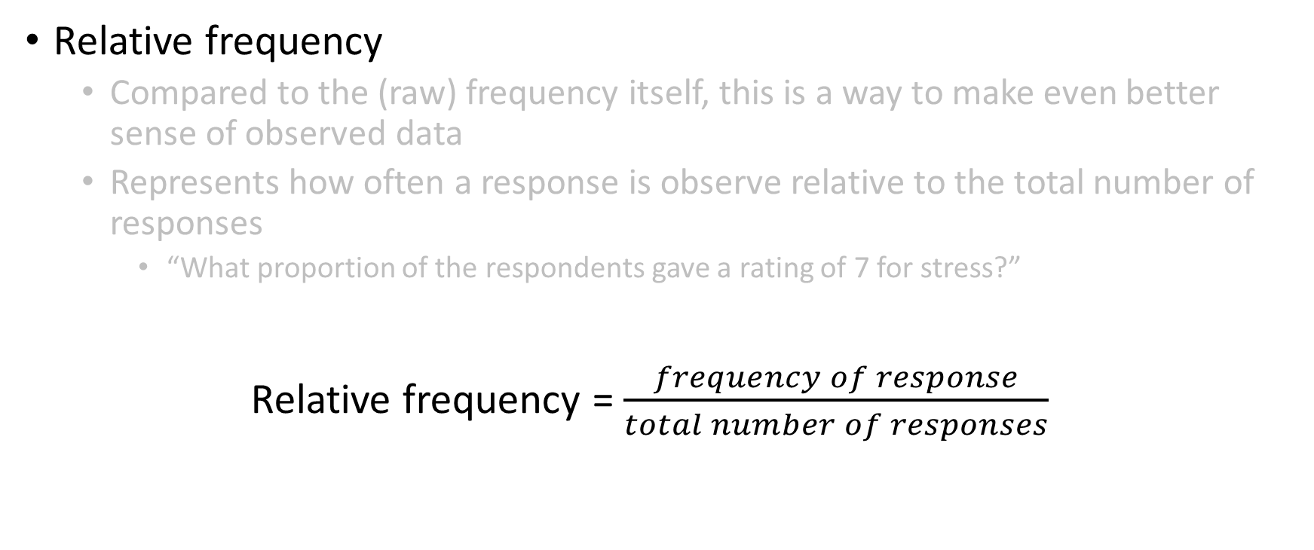
Summarizing Data
Relative frequency
Compared to the (raw) frequency itself, this is a way to make even better sense of observed data
Represents how often a response is observe relative to the total number of responses
“What proportion of the respondents gave a rating of 7 for stress?”
Relative frequency = $\frac{frequency of response}{total number of responses}$

Slide 18
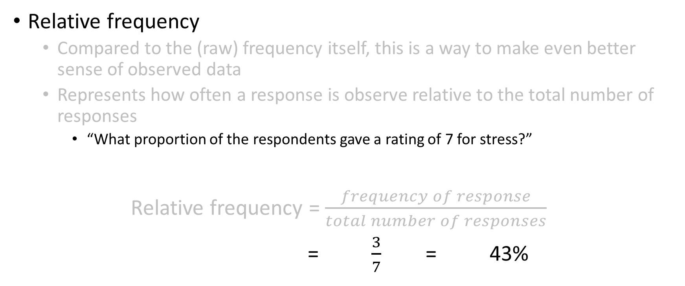
Summarizing Data
Relative frequency
Compared to the (raw) frequency itself, this is a way to make even better sense of observed data
Represents how often a response is observe relative to the total number of responses
“What proportion of the respondents gave a rating of 7 for stress?”
Relative frequency = $\frac{frequency of response}{total number of responses}$
= $\frac{3}{7}$ = 43%

Slide 19
Summarizing Data
Cumulative frequency and cumulative percentage
An assessment of the total frequency (percentage) of all categories up to and including the category of interest

Slide 20
Summarizing Data
Cumulative frequency and cumulative percentage
An assessment of the total frequency (percentage) of all categories up to and including the category of interest
Cumulative frequency_{n} = frequency_{n} + cumulative frequency_{n-1}

Slide 21
Summarizing Data
Cumulative frequency and cumulative percentage
An assessment of the total frequency (percentage) of all categories up to and including the category of interest
Cumulative percentage_{n} = percentage_{n} + cumulative percentage_{n-1}

Slide 22
Summarizing Data
Mean (or median) splits
A method used to estimate the number of “high” vs. “low” responses observed in a dataset

Slide 23
Summarizing Data
Mean (or median) splits
A method used to estimate the number of “high” vs. “low” responses observed in a dataset
Example: How many people have “high” and “low” levels of job satisfaction?

Slide 24
Summarizing Data
Mean (or median) splits
A method used to estimate the number of “high” vs. “low” responses observed in a dataset
Example: How many people have “high” and “low” levels of job satisfaction?

Slide 25

Summarizing Data
Mean (or median) splits
A method used to estimate the number of “high” vs. “low” responses observed in a dataset
Example: How many people have “high” and “low” levels of job satisfaction?
Step 1: Calculate column mean (average)
Average job satisfaction rating = $\frac{7+7+7+8+3+4+4}{7}$ = 5.71

Slide 26

Summarizing Data
Mean (or median) splits
A method used to estimate the number of “high” vs. “low” responses observed in a dataset
Example: How many people have “high” and “low” levels of job satisfaction?
Step 1: Calculate column mean (average)
Average job satisfaction rating = $\frac{7+7+7+8+3+4+4}{7}$ = 5.71
Step 2: Rearrange observed data (largest → smallest)

Slide 27

Summarizing Data
Mean (or median) splits
A method used to estimate the number of “high” vs. “low” responses observed in a dataset
Example: How many people have “high” and “low” levels of job satisfaction?
Step 1: Calculate column mean (average)
Average job satisfaction rating = $\frac{7+7+7+8+3+4+4}{7}$ = 5.71
Step 2: Rearrange observed data (largest → smallest)
Step 3: Identify “high” (i.e., > 5.71) vs. “low” (i.e., < 5.71) scores

Slide 28

Summarizing Data
Mean (or median) splits
A method used to estimate the number of “high” vs. “low” responses observed in a dataset
Example: How many people have “high” and “low” levels of job satisfaction?
Step 1: Calculate column mean (average)
Average job satisfaction rating = $\frac{7+7+7+8+3+4+4}{7}$ = 5.71
Step 2: Rearrange observed data (largest → smallest)
Step 3: Identify “high” (i.e., > 5.71) vs. “low” (i.e., < 5.71) scores
Step 4: Calculate “high” vs. “low” frequencies and percentages

Slide 29
Summarizing Data
4 out 7 =“high” scores
4/7 = .57 (57%)
3 out 7 =“low” scores
3/7 = .43 (43%)
Mean (or median) splits
A method used to estimate the number of “high” vs. “low” responses observed in a dataset
Example: How many people have “high” and “low” levels of job satisfaction?
Step 1: Calculate column mean (average)
Average job satisfaction rating = $\frac{7+7+7+8+3+4+4}{7}$ = 5.71
Step 2: Rearrange observed data (largest → smallest)
Step 3: Identify “high” (i.e., > 5.71) vs. “low” (i.e., < 5.71) scores
Step 4: Calculate “high” vs. “low” frequencies and percentages

Slide 30
Central tendency
Mean, median, mode

Slide 31
Central tendency
Mean, median, mode

Slide 32
Central tendency
Mean, median, mode
Honestly, we are mostly just interested in the mean

Slide 33
Variance
Skewness
Kurtosis

Slide 34
Shape
Skewness
Kurtosis

Slide 35
Threats to descriptive statistics
Missing data
Outliers
Range restriction

Slide 36
Interpreting descriptive statistics

